Slide 1
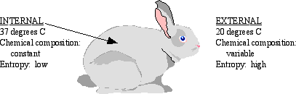

What it means to be alive..a steady state or an equilibrium?

Slide 2
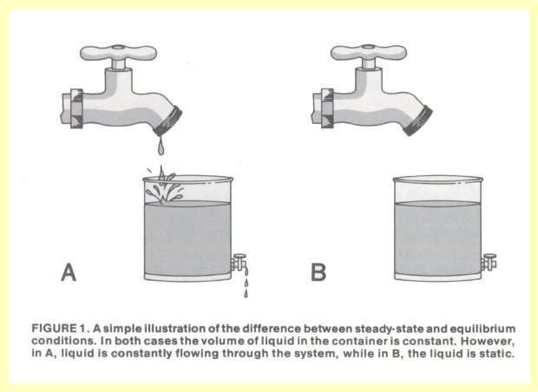
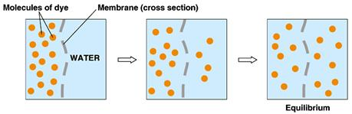
Steady State vs Equilibrium

Slide 3
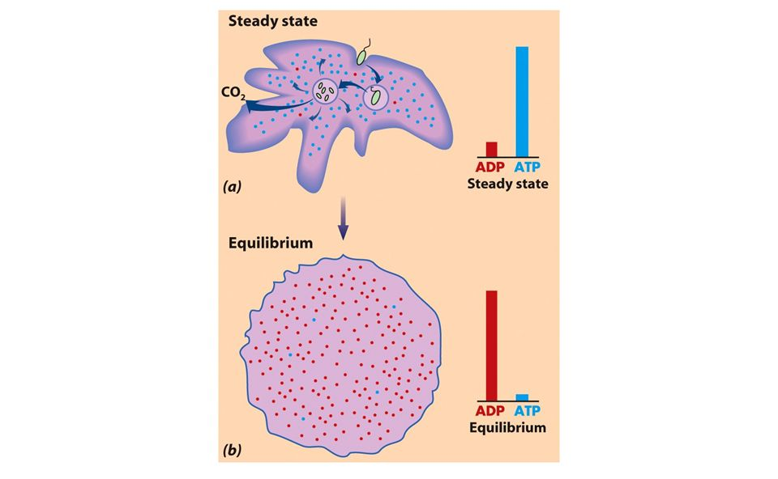
Steady State vs Equilibrium

Slide 4
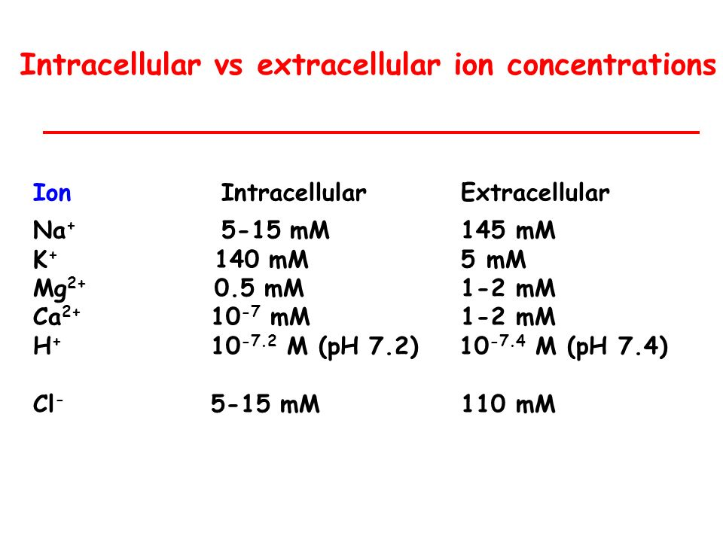

Slide 5
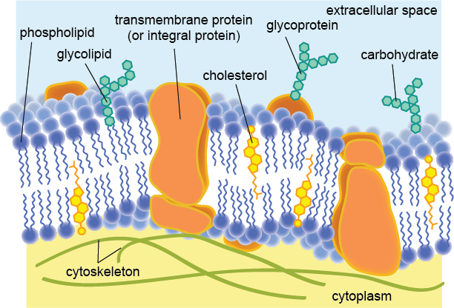
Structure of the membrane

Slide 6
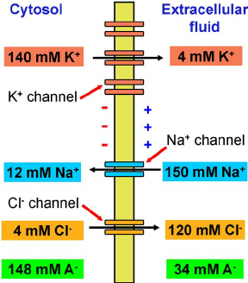
Transport across membrane

Slide 7
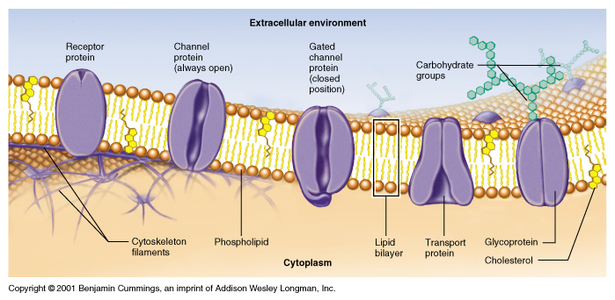
Channels

Slide 8
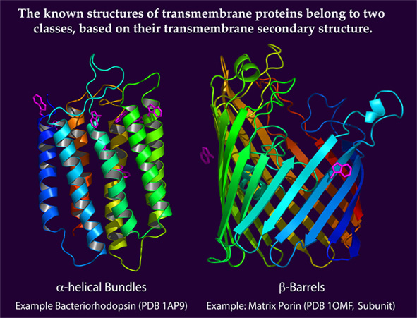
Channels

Slide 9
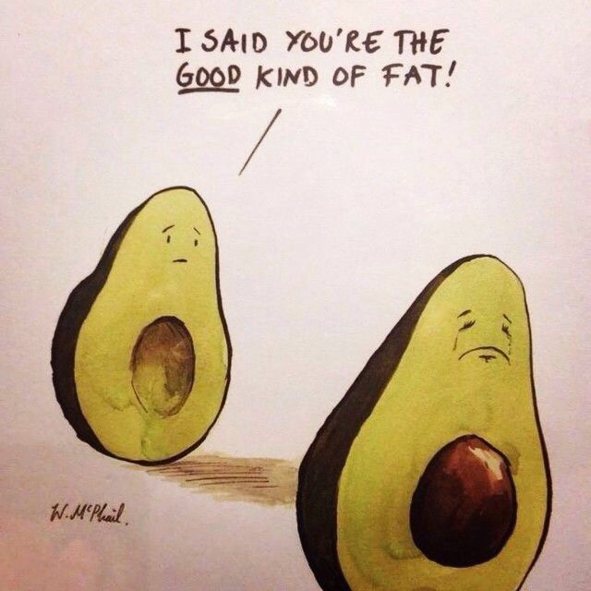
Lipids and Fatty acids

Slide 10
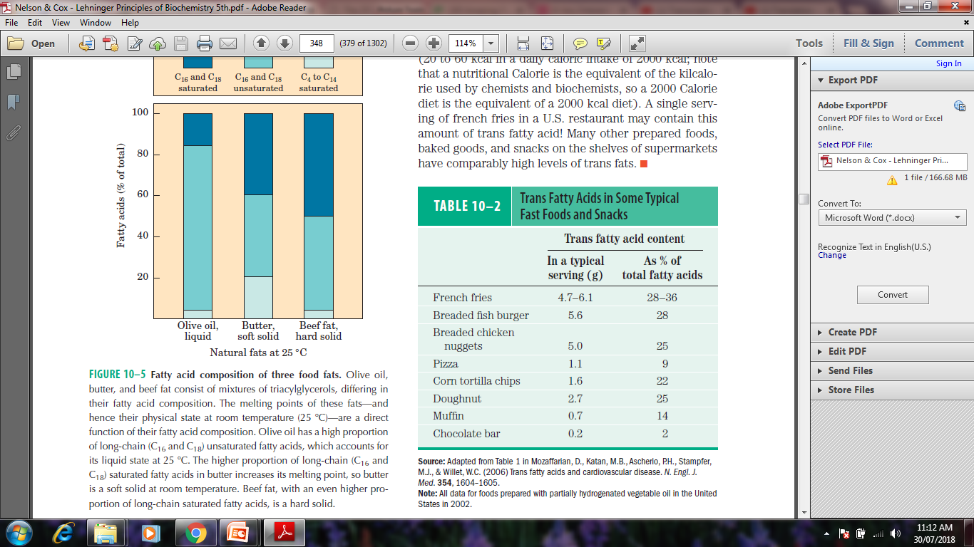
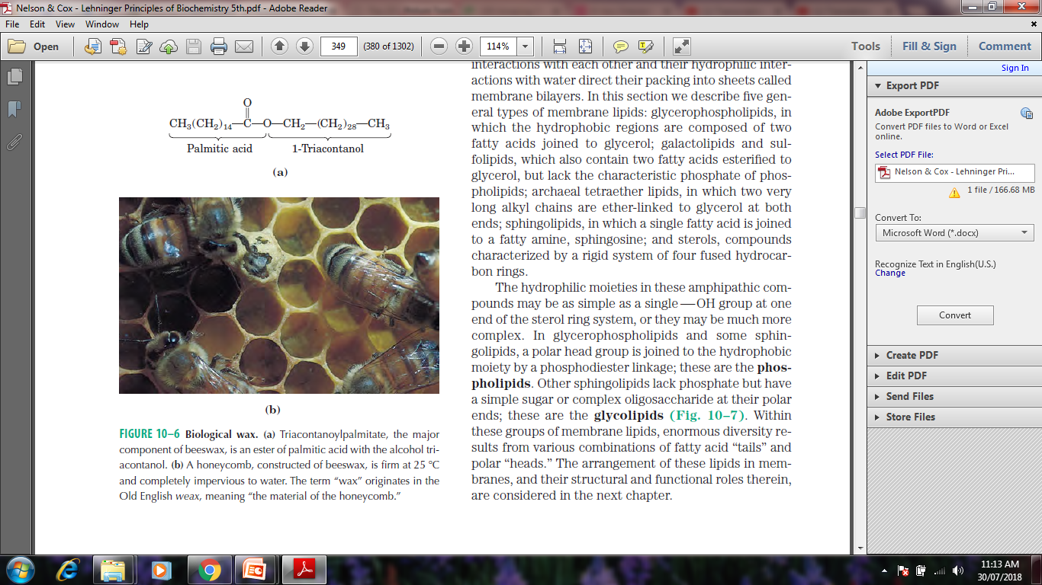
Lipids and Fatty Acids

Slide 11
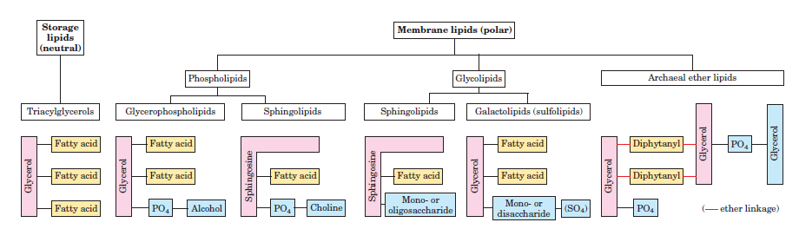
Classification of Lipids

Slide 12
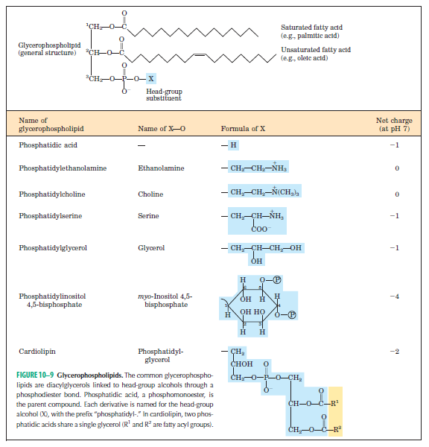
Glycerolipids

Slide 13
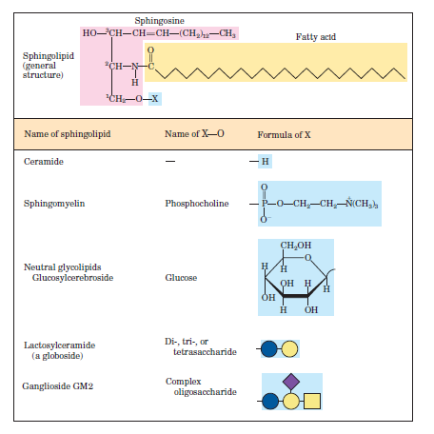
Sphingolipids

Slide 14
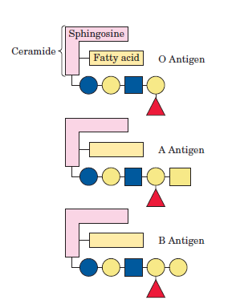
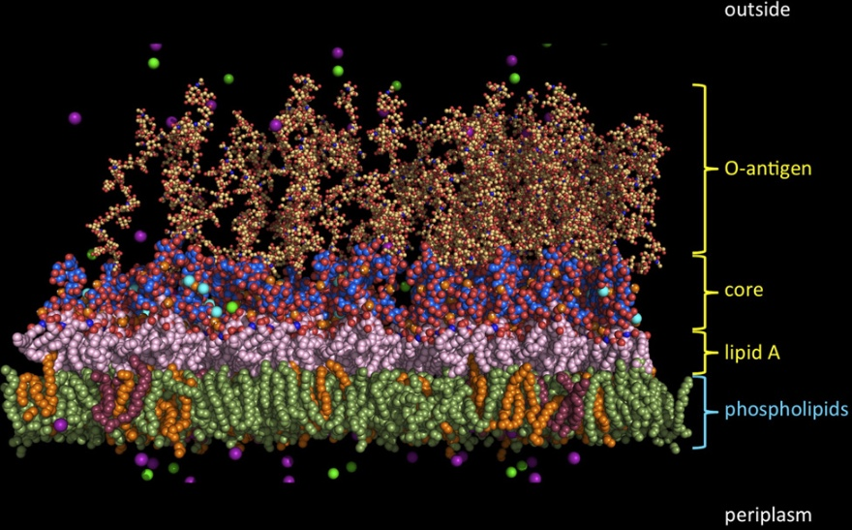
Lipids as Blood Group determinants

Slide 15
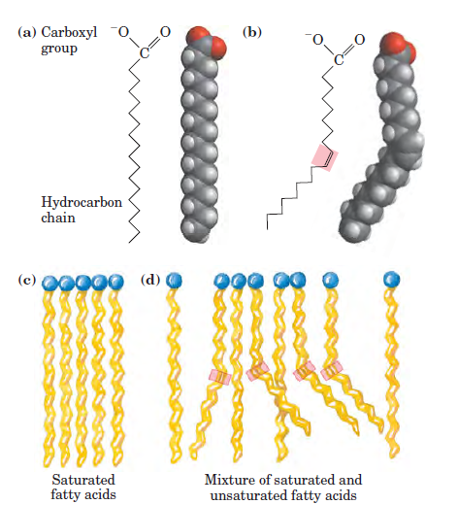
Lipids in Plasma Membrane

Slide 16
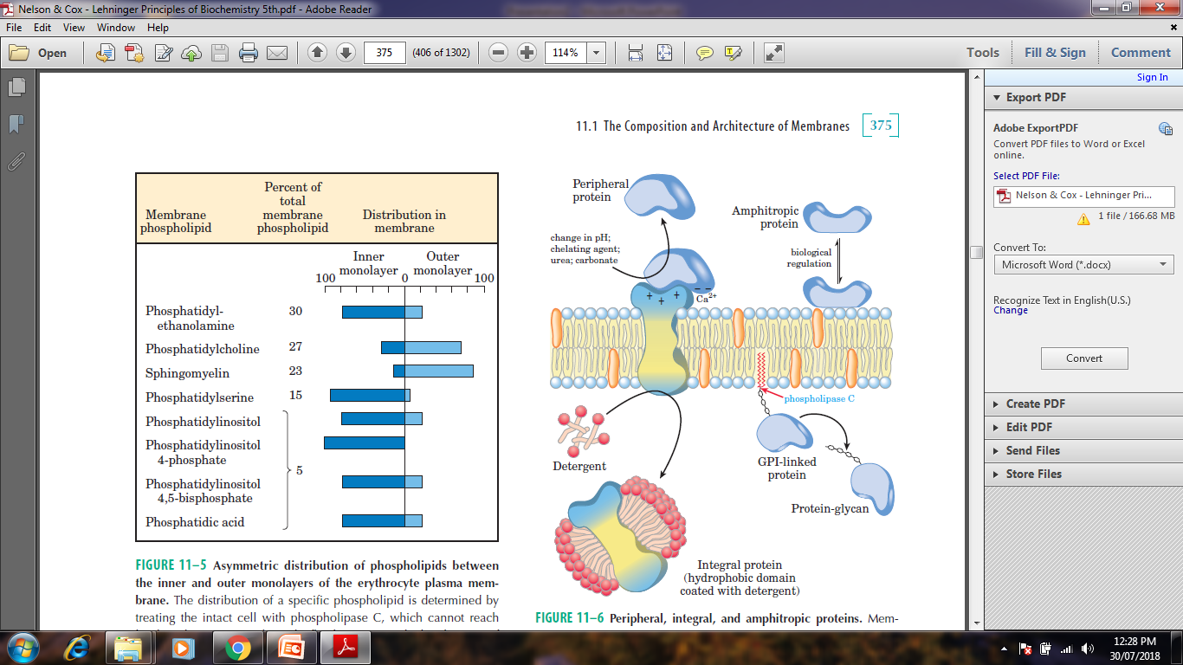
Lipids in Plasma Membrane

Slide 17

VITAMINS

Slide 18
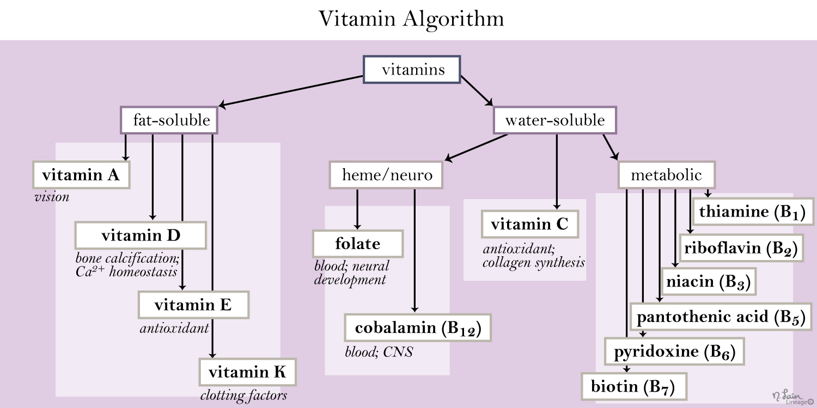

Slide 19
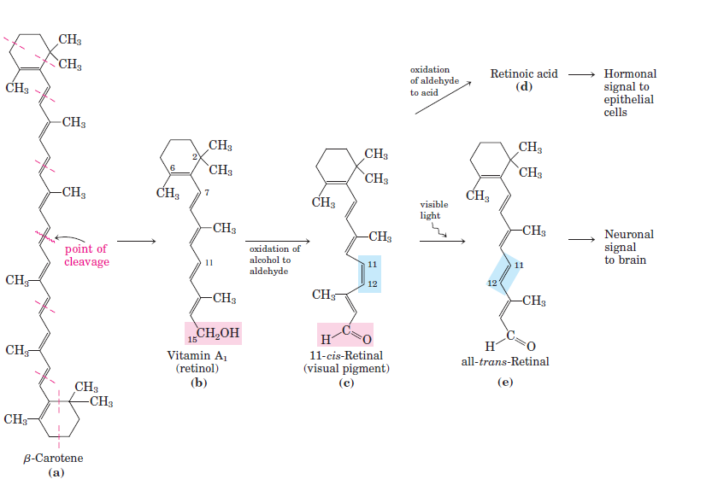
Vitamin A

Slide 20
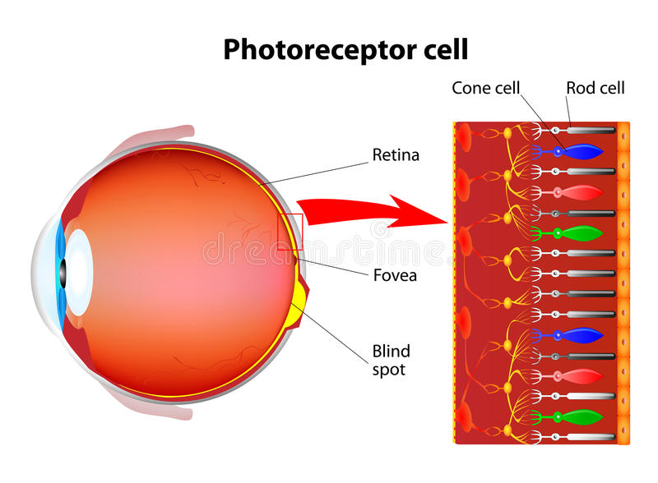
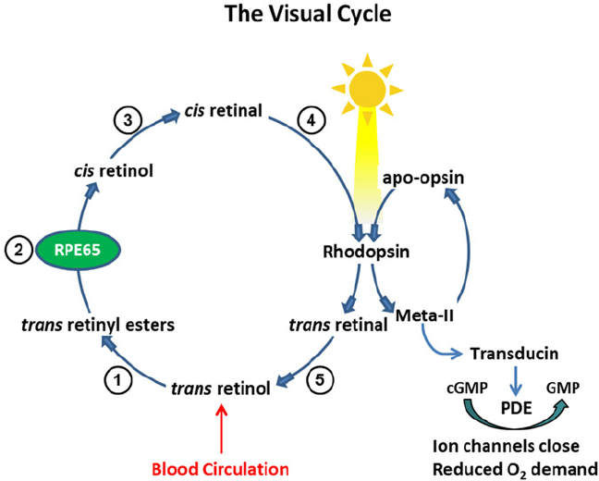
Vitamin A

Slide 21
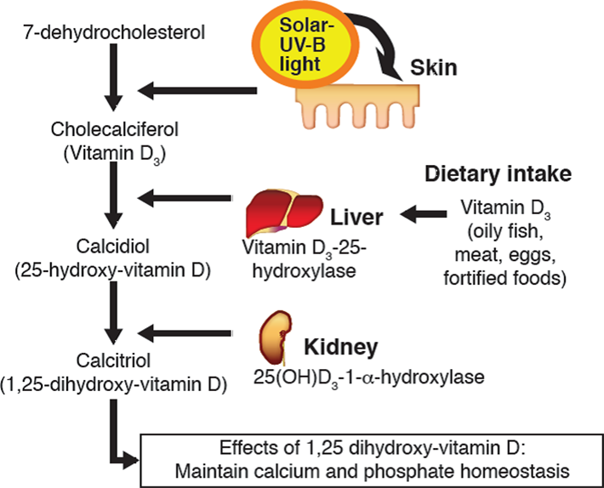
Vitamin D

Slide 22
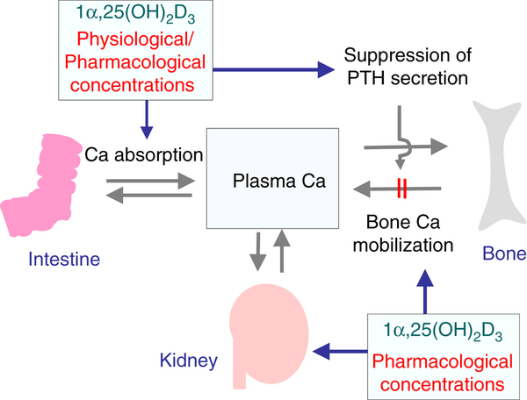
Vitamin D

Slide 23
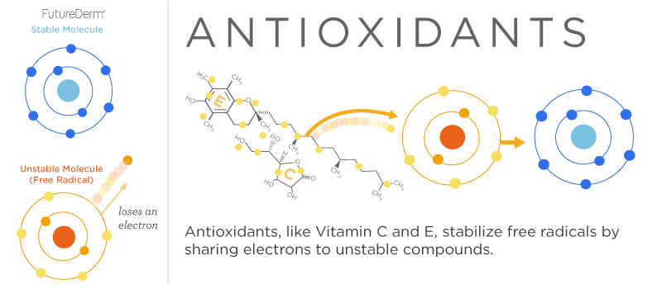
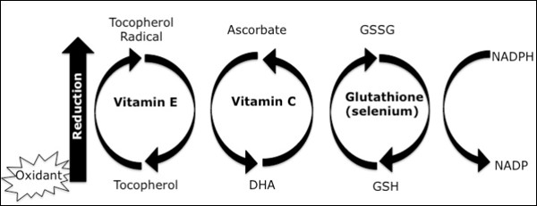
Vitamin E

Slide 24
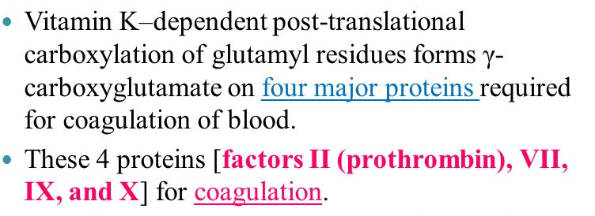
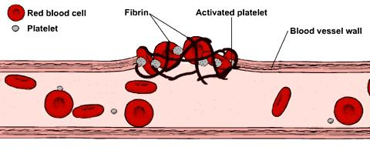
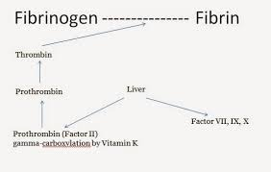
Vitamin K

Slide 25
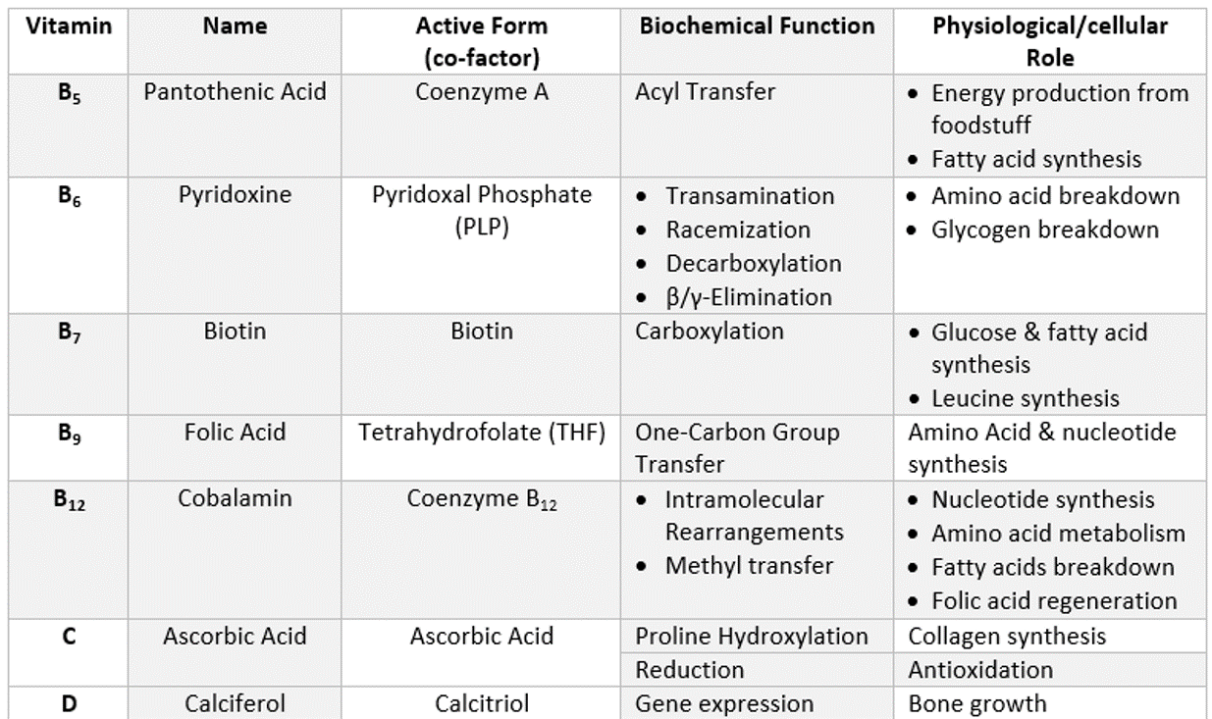
Vitamin B complex

Slide 26
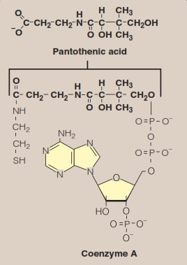
Vitamin B5

Slide 27
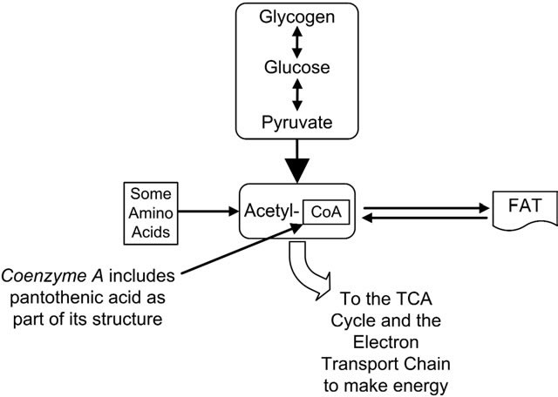
Vitamin B5

Slide 28
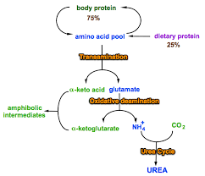
Vitamin B6

Slide 29
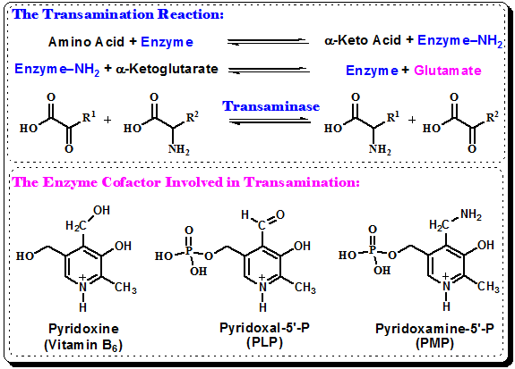
Vitamin B6

Slide 30
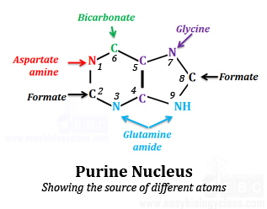
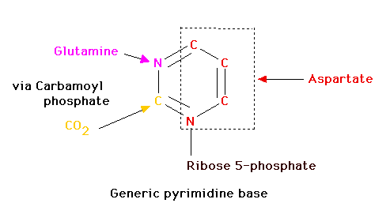
Nucleotide synthesis

Slide 31
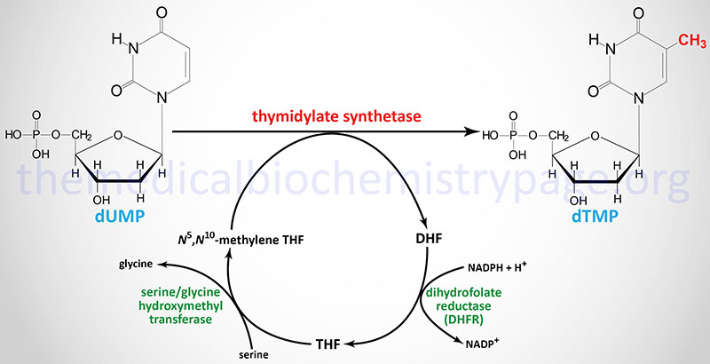
Vitamin B9

Slide 32
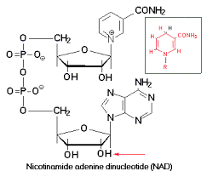
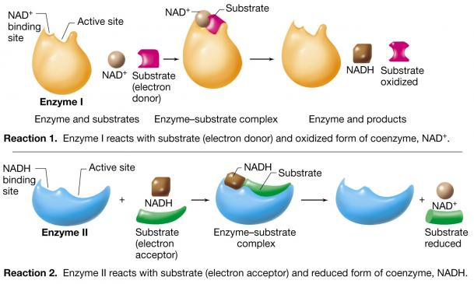
Vitamin B3

Slide 33
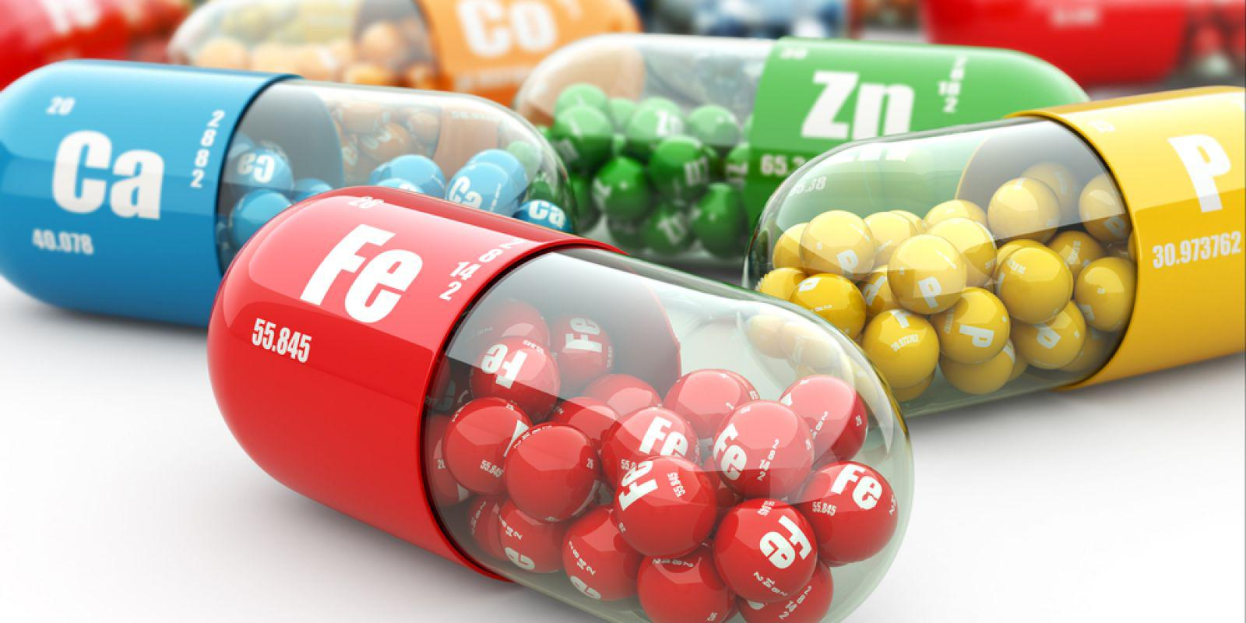
MINERALS

Slide 34
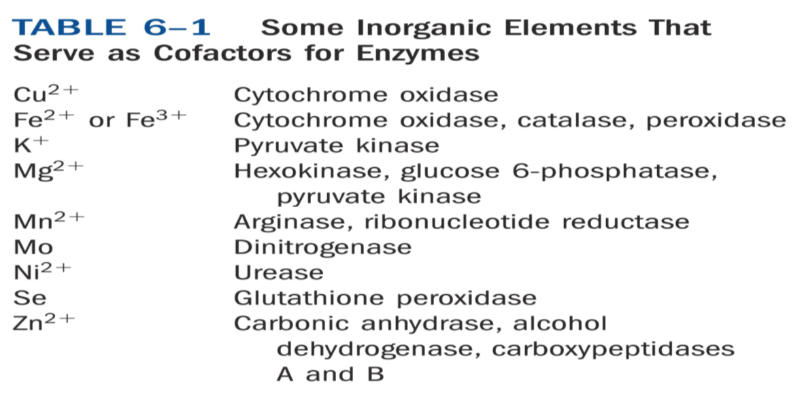
Some roles of Micronutrients

Slide 35
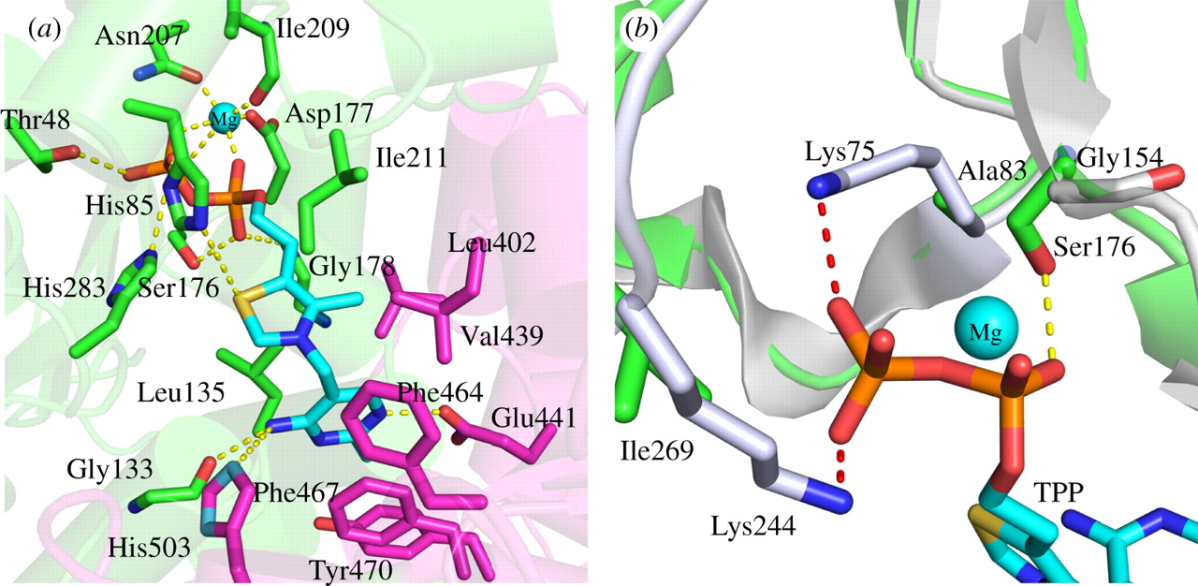
Mg²⁺ ions
DNA polymerase

Slide 36
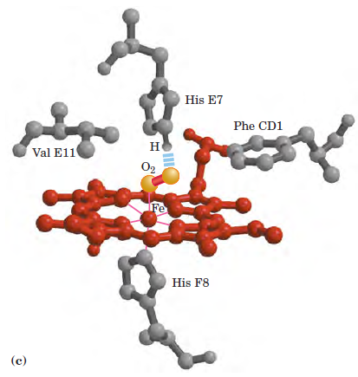
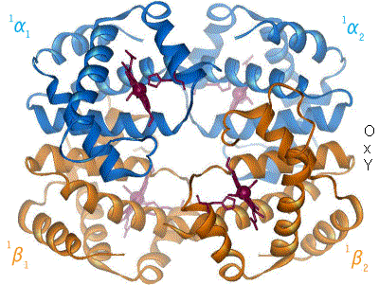
Fe²⁺ ions
Hemoglobin

Slide 37
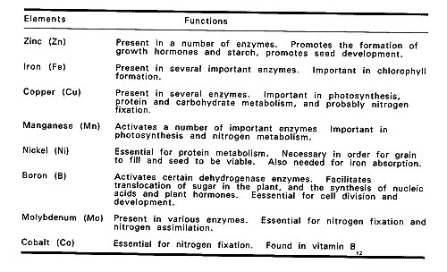

Slide 38
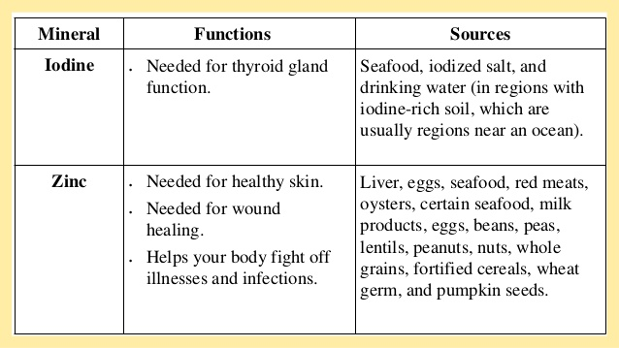
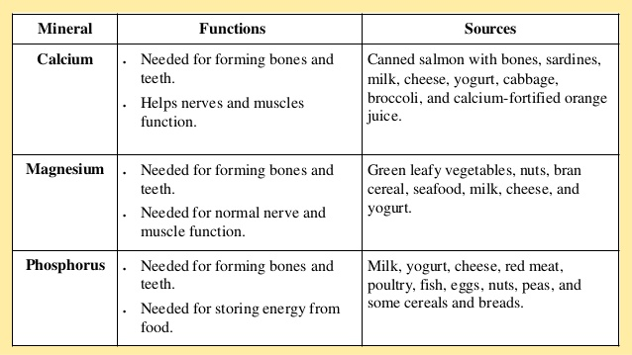

Slide 39
References:
1. Nelson And Cox, Lehninger Principles of Biochemistry, 6th edition
2. Bioinformatics: Joel Keizer
3. Images: Search engine Google.
4. Harper’s Biochemistry 26th Edition.
5. Genes- VIII, Lewin
6. Developmental Biology by Gilbert 7th Edition
7. https://www.yourgenome.org/stories/evolution-of-modern-humans
8. https://www.nature.com/articles/153742a0
9.https://en.wikibooks.org/wiki/Structural_Biochemistry/Protein_function/Hemoglobin

